Slide 1
Traffic Sign Detection & Classification Using DL & Model Comparison
Shadman Sakib | 1813190642
Talukder Abdullah Al Talha | 1813193642
Md. Sharukh Fardin | 1821463042

Slide 2




Introduction
Nowadays traffic accident is a common incident around the world. About 3700 people on average are dying in traffic accidents around the world everyday and about 1.35 million are dying in a year.

Slide 3

Problem Statement
One of the main reasons of road accidents are lack of knowledge of the drivers about traffic signs.
Sometimes the drivers can not see the traffic signs properly due to bad light.
Bad eyesight is one of the major reasons for not seeing the traffic signs.

Slide 4

Aim Of Our Project
The main purpose of our project is to build a virtual system which can detect and classify the traffic signs even in bad light.
Drivers who have bad eyesight can be hugely benefited by our project.
Drivers with lack of traffic knowledge can also take help from our project.
In future, we will try to apply this project for automated cars.
Finally, we will compare the accuracy of three different models : YOLOv5 , SSD , Faster RCNN.

Slide 5
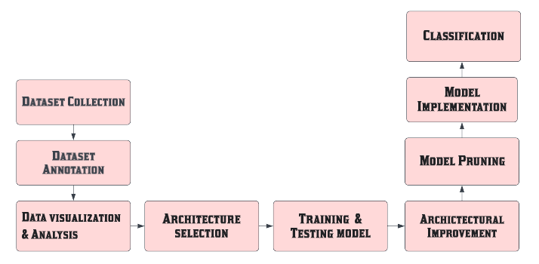
Workflow

Slide 6
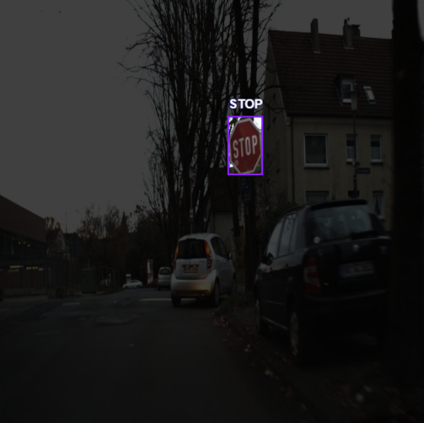
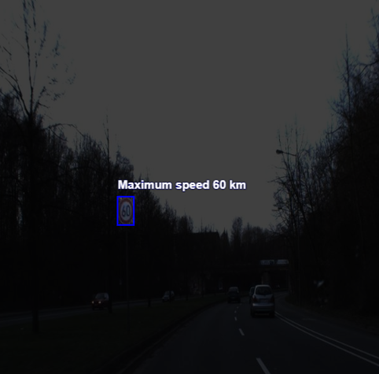
What We Have Done So Far
1. Dataset Collection.
2. Dataset annotation and labelling.
3. Generated the CSV file of the dataset.
4. Researched about related works by reading papers.

Slide 7

Barriers
While collecting the dataset, we found some images which were not clearly visible and blurred.
Some traffic signs in the images were not well known so that we have to collect the informations from some other sources.

Slide 8

Future Plan for CSE499B
Applying YOLOv5 , Faster RCNN, SSD.
Applying CNN.
Feature Extraction.
Feature Classification.
Testing and improving our accuracy.
Comparing three different accuracy results.
Finalizing our project.

Slide 9


